Slide 1
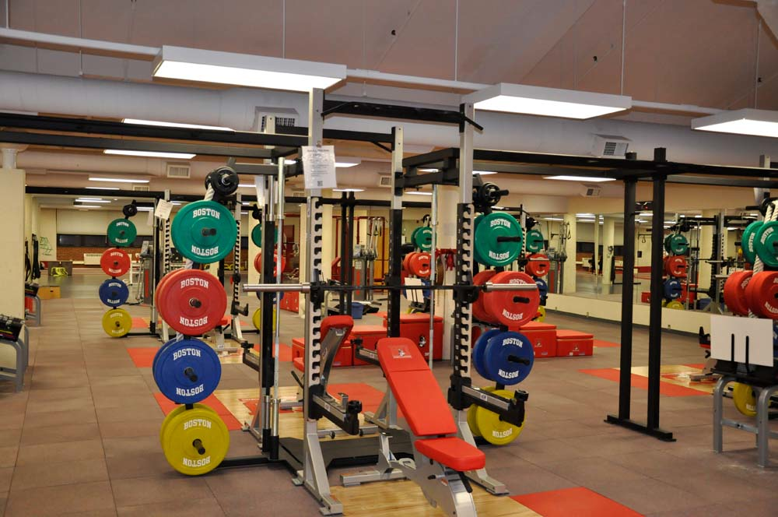
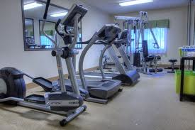
Fitness Facility Project Intro. to Sports Medicine

Slide 2
Examples of Layouts

Slide 3
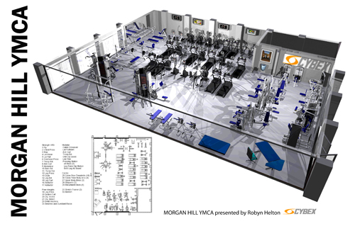
Layouts

Slide 4
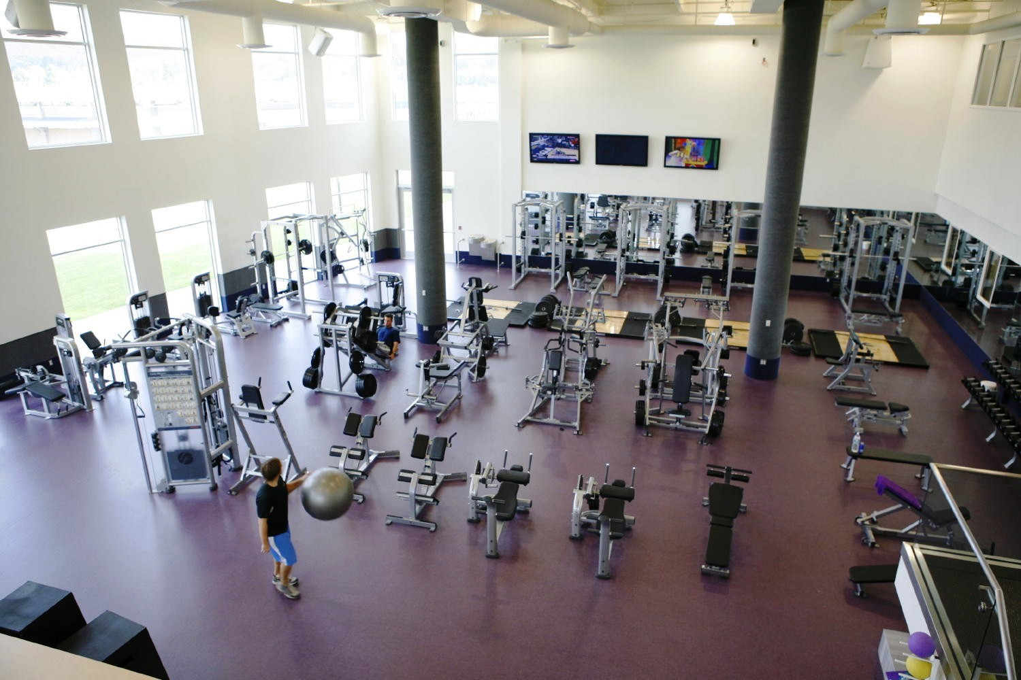

Slide 5
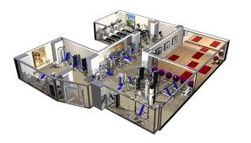

Slide 6
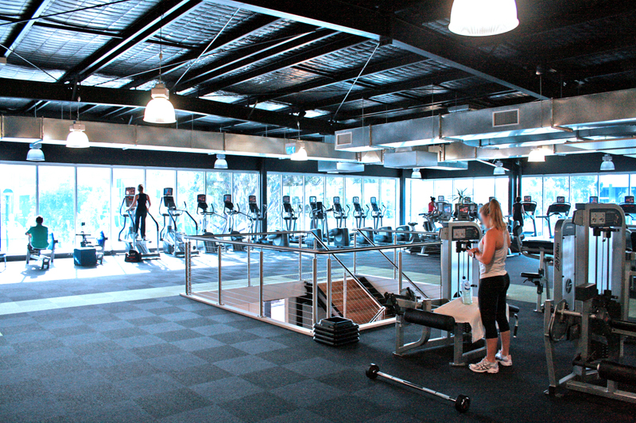

Slide 7
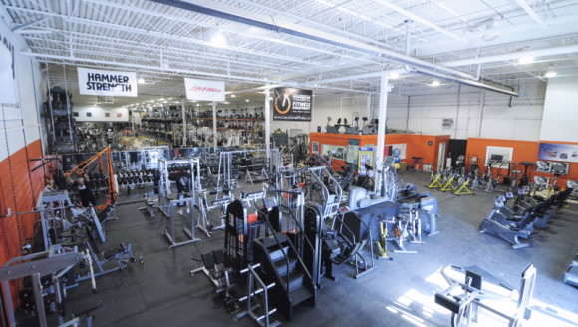

Slide 9
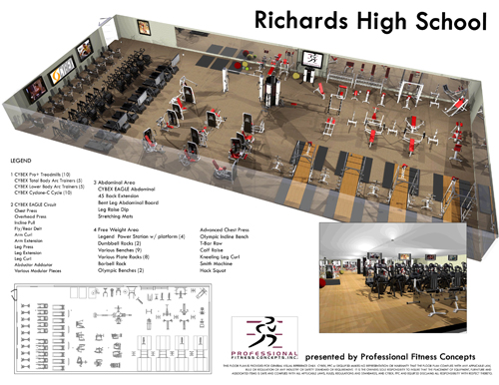

Slide 10
Promotional Materials

Slide 11
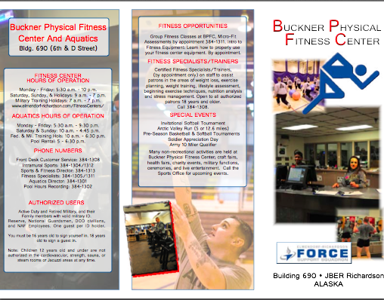

Slide 12
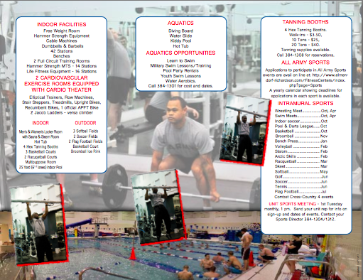

Slide 13
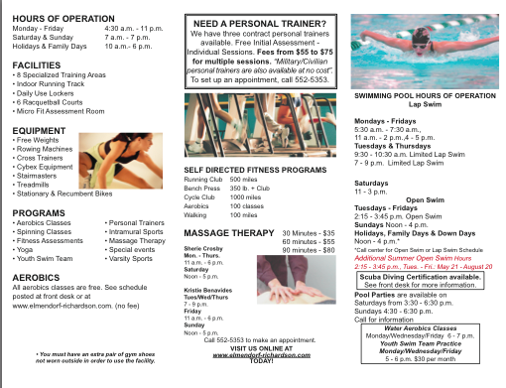

Slide 17
Creating a Budget
ABC Health Club | Daily Operation Budget
Daily Hours of Operation: 5am to 11pm
Department: Fitness Department
Employee Position | Shift | Hours Worked | Rate | Total (Before Taxes)
Personal Trainer | 5:00am to 1:00pm | 8 hours | $12.00 | $96.00
Personal Trainer | 8:00am to 4:00pm | 8 hours | $12.00 | $96.00
Personal Trainer | 12:00pm to 8:00pm | 8 hours | $12.00 | $96.00
Personal Trainer | 3:00pm to 10:00pm | 8 hours | $12.00 | $96.00
Front Desk Staff | 4:45am to 10:00am | 5.25 Hours | $12.00 | $63.00
Front Desk Staff | 7:00am to 3:00pm | 8 hours | $10.00 | $80.00
Front Desk Staff | 8:30am to 4:30pm | 8 hours | $10.00 | $80.00
Front Desk Staff | 10:00am to 6pm | 8 hours | $10.00 | $80.00
Front Desk Staff | 3:00pm to 7:00pm | 4 hours | $10.00 | $40.00
Front Desk Staff | 4:30pm to 8:30pm | 4 hours | $10.00 | $40.00
Front Desk Staff | 7:00pm to 11:15pm | 3.25 hours | $10.00 | $32.50
 |  | Total Salary for Fitness Department |  | $799.50
Department: Customer Service
Job Title | Shift | Total Hours | Hourly Rate | Total (Before Taxes)
Front Desk Staff | 4:45am to 10:00am | 5.25 Hours | $12.00 | $63.00
Front Desk Staff | 7:00am to 3:00pm | 8 hours | $10.00 | $80.00
Front Desk Staff | 8:30am to 4:30pm | 8 hours | $10.00 | $80.00
Front Desk Staff | 10:00am to 6pm | 8 hours | $10.00 | $80.00
Front Desk Staff | 3:00pm to 7:00pm | 4 hours | $10.00 | $40.00
Front Desk Staff | 4:30pm to 8:30pm | 4 hours | $10.00 | $40.00
Front Desk Staff | 7:00pm to 11:15pm | 3.25 hours | $10.00 | $32.50
Membership Sales | 9:30 am to 5:30pm | 8 hours | $15.00 | $120.00
Membership Sales | 11:30pm to 7:30pm | 8 hours | $15.00 | $120.00
 |  | Total Salary for Customer Service |  | $655.50
Department: Group Fitness
Job Title | Shift | Total Hours | Hourly Rate | Total (Before Taxes)
Group Fitness Instructor | 8am | 1 hour | $30.00 | $30.00
Group Fitness Instructor | 9am | 1 hour | $30.00 | $30.00
Group Fitness Instructor | 10am | 1 hour | $30.00 | $30.00
Group Fitness Instructor | 12pm | 1 hour | $30.00 | $30.00
Group Fitness Instructor | 4pm | 1 hour | $30.00 | $30.00
Group Fitness Instructor | 5pm | 1 hour | $30.00 | $30.00
Group Fitness Instructor | 6pm | 1 hour | $30.00 | $30.00
Group Fitness Instructor | 7pm | 1 hour | $30.00 | $30.00
 |  | Total Salary for Group Fitness |  | $240.00
Department: Maintenance
Job Title | Shift | Total Hours | Hourly Rate | Total (Before Taxes)
Maintenance | 6:30am to 2:30pm | 8 hours | $13.00 | $104.00
Maintenance | 8:30am to 4:30pm | 8 hours | $13.00 | $104.00
Maintenance | 12:00pm to 8:00pm | 8 hours | $13.00 | $104.00
Maintenance | 3:00pm to 11:00pm | 8 hours | $13.00 | $104.00
 |  | Total Salary for Maintenance |  | $416.00
 |  | Total Salary Per Day for All Employees |  | $2,111.00

Slide 18
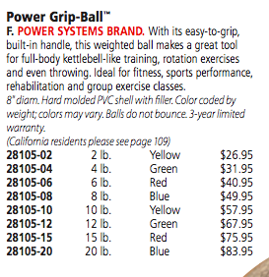
Creating Product Budget
Item Description
Item/Catalog Number
Cost Per Unit
Additional Information for Item Description
Catalog Used: Power Systems
Item/Catalog Number | Item Description | Quanitity | Unit Price | Total Price
25232-01 | 2lb- Basic Power Med-Ball | 4 | $23.95 | $95.80
28105-06 | 6lb- Power Grip Ball | 6 | $40.95 | $245.70
 |  |  | Total | $341.50

Slide 19
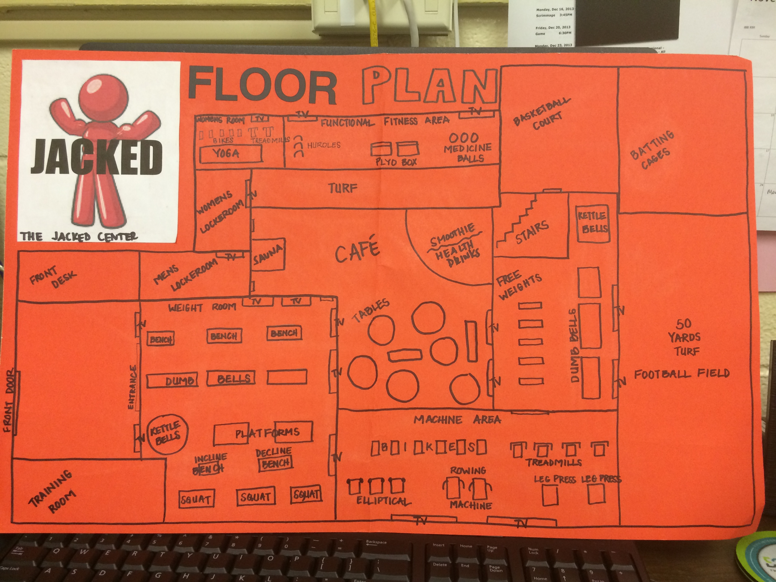
Student Examples

Slide 20
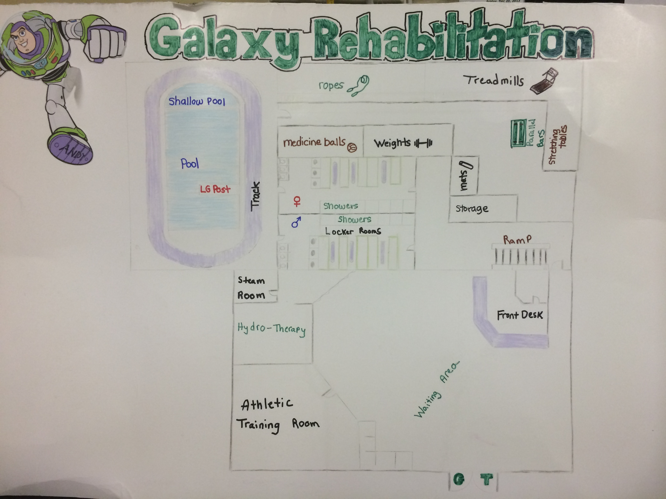
Student Examples

Slide 21
Resources
Can be viewed on my Website
www.ploe.weebly.com
Catalogues from
Perform Better
Gopher Sports
Power Systems

